Slide 1
BS PROJECT – Mid semester presentation
Title: Comparative Analysis of Different Models and Techniques for Object Detection and Character Recognition
By – Mehul Paithane - 18142

Slide 2
Contents
Introduction
Objectives
Background
Software and tools
Materials and methods
Results

Slide 3
Introduction
Number of vehicles are increasing everyday. Leading to an increase in number of traffic rule violations.
ANPR system requires 3 components:
Helmet plate detection
Licence plate detection.
Text extraction.
We shall only focus on 2-wheeler vehicles due to their large number.

Slide 4
objectives
The main objectives of this project are:
To make a fraction of the whole ANPR model and make the job of law-enforcers easier.
Use different models and techniques to make object-detection models and character recognition models. Compare their efficiency.

Slide 5
Background
Projects on Kaggle like: ANPR project in 2018.
Research papers on object – detection and character recognition models:
Automatic Number Plate Recognition System (ANPR): A Survey.
YOLO: Unified, Real- Time Object Detection.
License Plate Detection and Recognition Using OpenCV–Python

Slide 6
Software & tools
For our dynamic python programming needs, we use jupyter notebook.
For extensive programming where a TPU deployment is necessary, we use google colaboratory.

Slide 7
Materials and Methods
Data acquisition
Helmet detection: Trained using YOLOv3 CNN model. Dataset acquired from kaggle. Consisting of cfg and weight files with images.
License plate detection: Annotation and image dataset for 4 – wheelers is used as same dataset for 2 – wheelers is not available. Also taken from kaggle.
Character extraction: 2 datasets are acquired for this task:
For densenet: Dataset consisting of 36 classes with 1030 images in each is used.
For Pytesseract (openCV): Dataset of 36 classes with 30 images is used to check accuracy.

Slide 8
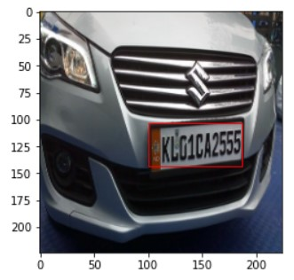
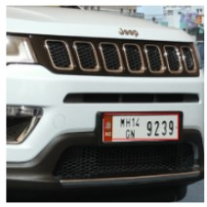
Results (Image output)
Object detection: Licence Plate – using CNN

Slide 9
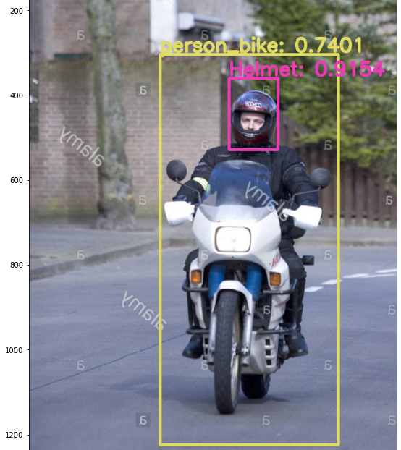
Continued…
Object detection – helmet: using YOLOv3

Slide 10
Output (accuracy and loss)
Accuracy of object detection model (license plate detection) used using CNN is:
Accuracy | 80.46 %
Loss | 11.23 %

Slide 11
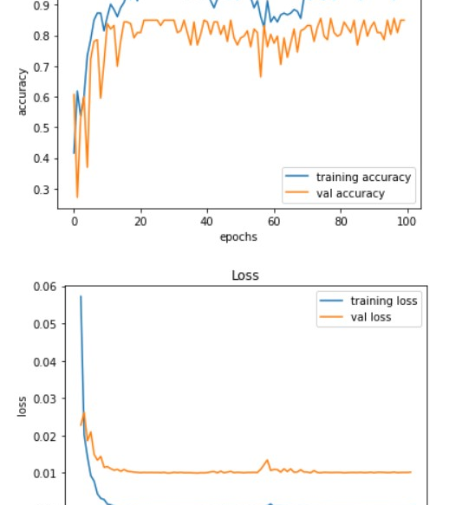
Continued…
Accuracy and loss against the number of epochs.

Slide 12
Continued…
Accuracy of object detection model (license plate detection) used using CNN is:
Model | Accuracy
Person on bike | 74.01%
Helmet detection | 91.54%

Slide 13
Conclusion
The accuracy of the object-detection model used to detect helmets is higher than that of the license plate.
Therefore: YOLOv3 is better.

